Slide 1

Spares on Web
SoW
Manual
Unrestricted © Siemens 2020
siemens.com/sow
Notes:
Hello and welcome to this Spares on Web Manual. In the following you will learn more about the web-based information system Spares on Web, or SoW for short.

Slide 2
Content
Sign-up and registration
Siemens employees
Externally authorized repair center
-
Search options
Single search
with article number
with article number and serial number
with article number and options
Multi search
Modification of EWN-Motors
Shopping Cart → Service Mall
Login Service Mall
Examples – Electronics
Examples – Motors
Result lists
Spare parts and spare parts packages
Details
Packages & Modules
Excel-Export
-

Slide 3
Sign-up and registration
Notes:
Here you can find out how to register for SoW.

Slide 4
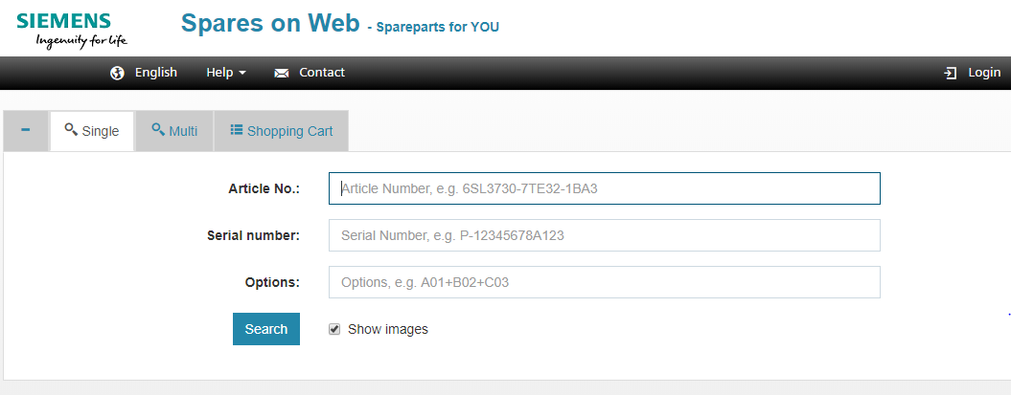
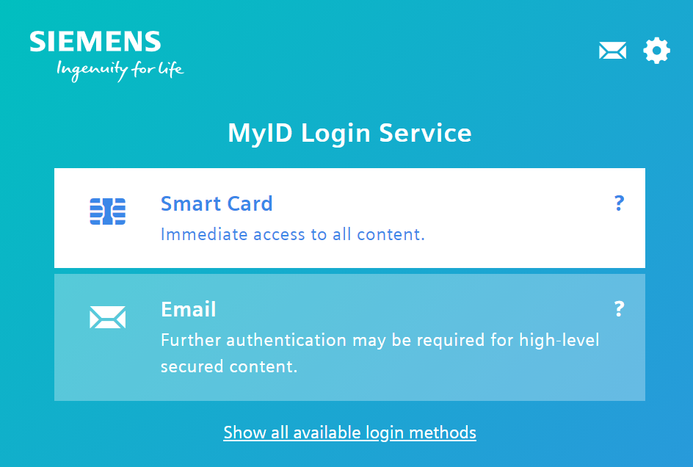
Sign-up and registration – Siemens employees
Sign-up via Smart Card or Email
Spares on Web is an open Tool to research for Spare Parts. A Login is only necessary for authorized Partners and Siemens employees, as they will see Parts, that are only available for them.
Notes:
Siemens employees can authenticate and log in at any time via MyID Login Service with Smart Card or Email.

Slide 5
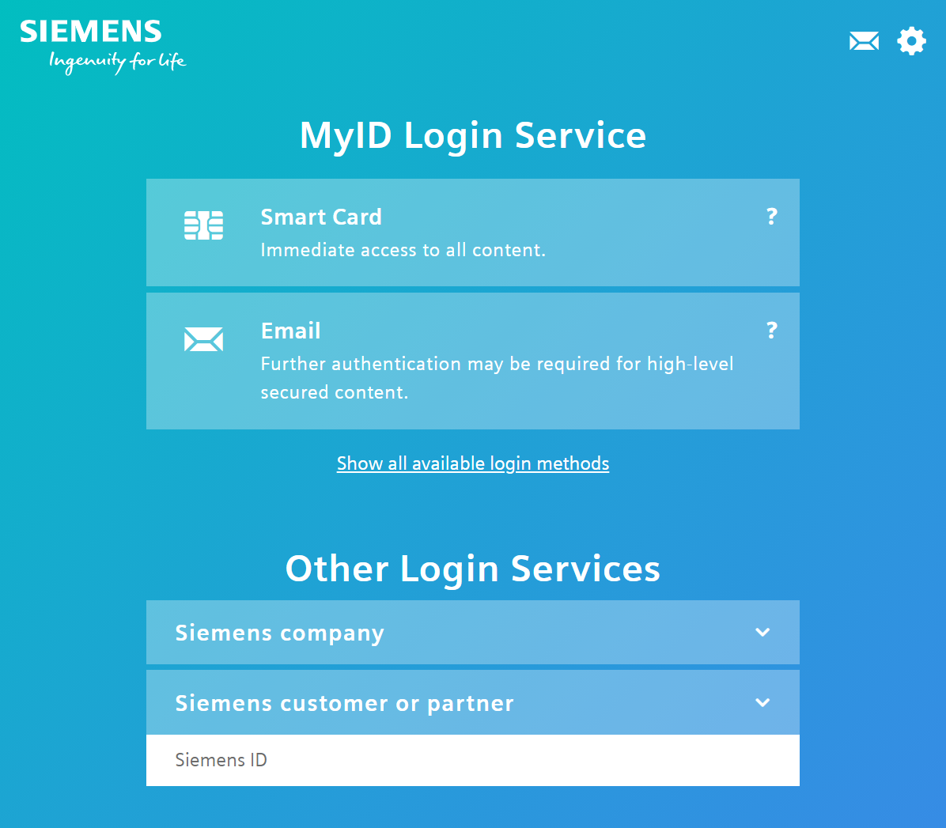
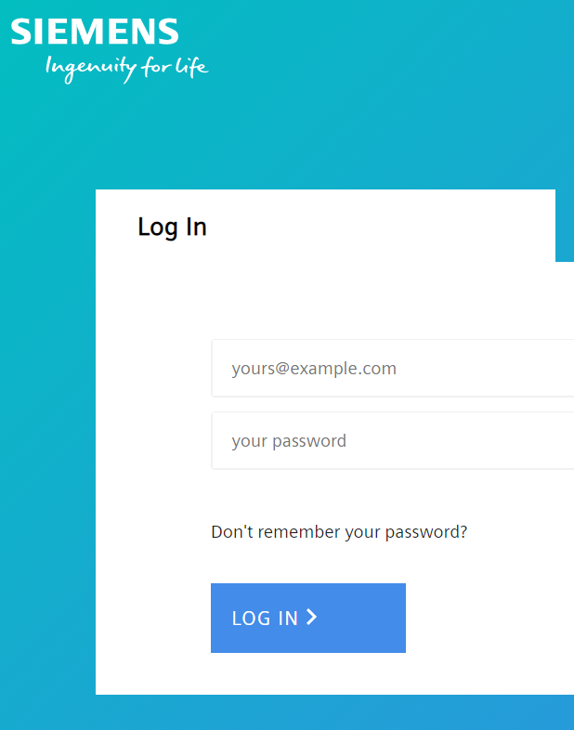
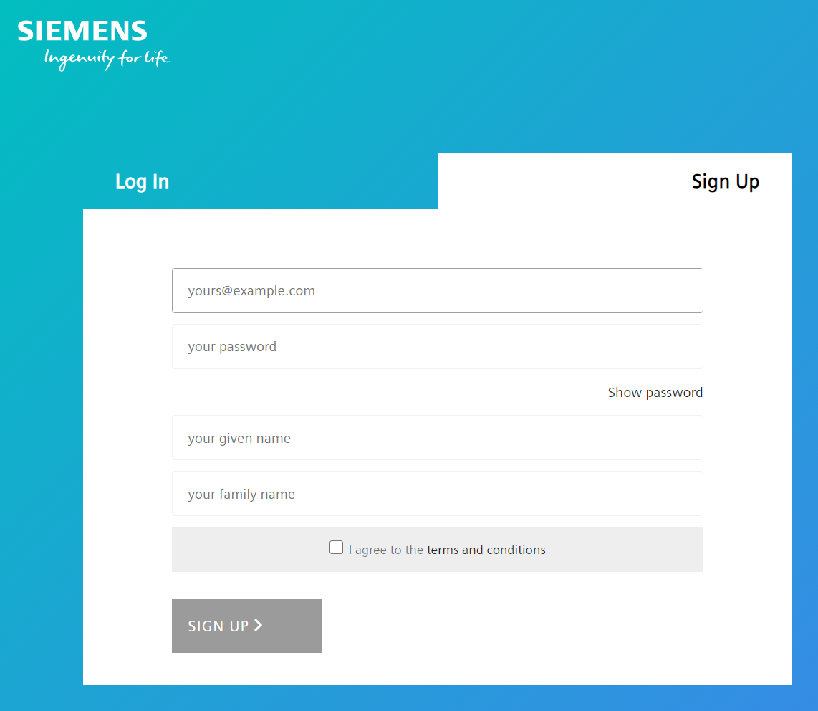
Sign-up and registration – Externally authorized repair center
Login works with e-mail and password.
You are an authorized Repair Partner/Repair site and have no Login yet?
Sign Up and after the first login to the Spares on Web get in contact with your Siemens Head Quarter contact to get rights assigned for specific information and functions.
Notes:
Authorized repair centers can contact their Service Headquarters representative for registration to obtain rights for specific information and functions.
In this case the login works with e-mail and password.

Slide 6
Search options
Notes:
In the following, we will introduce you to the search options available in Spares on Web and how you can work with them.

Slide 7
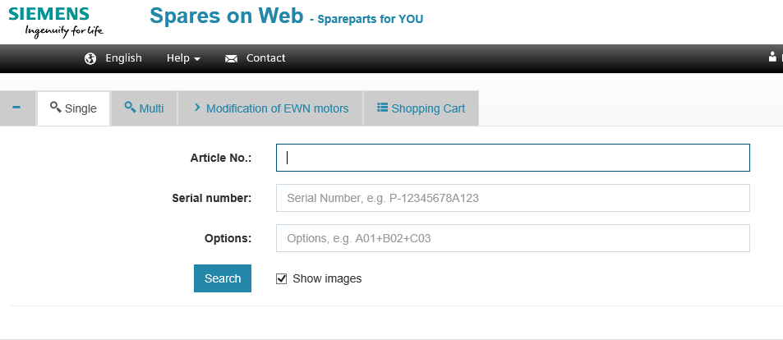
Search Options – Single Search
After logging in, various input windows are available for entering search criteria:
The Single-search allows you to enter search criteria for a product or system.
→ The search result is displayed in a list view.
→ The option for displaying the images in the result lists can be deactivated
Notes:
After logging in, various input windows are available for entering search criteria:
The Single-search allows you to enter search criteria for a product or system.
Multi-search allows you to enter search criteria for several products and systems.
The modification of EWN motor-search allows you to enter the search criteria for determining the required parts of an EWN motor modification.
The Note Pad enables the storage of complete or partial result lists and can be exported at any time.
Details on how to use these search options can be found on the following pages.

Slide 8

Single Search in detail – with article number
With the article number as the sole search criterion, all available parts are displayed as the result: spare parts, repair parts, wear parts and consumables, as far as this information is provided by the partner systems and you have the rights to see the information.
Please note that an article number must be a standardized product number, i.e. a machine-readable manufacturer number (MLFB), a Siemens part number (SSN) or a number according to the technical number system (TNS).
These result lists can be used to create parts lists (e.g. to keep spare parts in stock) before delivery.
Notes:
Finally, the Single-search also offers the option of entering only the article number as a search criterion.
With the article number as the sole search criterion, all essential parts are displayed as the result. You receive information about spare parts, repair parts, wear parts and consumables, as far as this information is provided by the partner systems.
These result lists can be used to create parts lists (e.g. to keep spare parts in stock) before delivery.

Slide 9
Single Search in detail – with article number and serial number
By entering an article number AND a Serial Number you will be able to see all information for a delivered Product with exactly the delivery configuration and parts list.
Notes:
There are different ways to use the search options.
The single search offers the possibility to search by article number and serial number, which is preferable from the point of view of compatibility.
If a searched part is not displayed, we recommend to start another search without serial number to see all essential parts.
Please note that an article number must be a standardized product number, i.e. a machine-readable manufacturer number (MLFB), a Siemens part number (SSN) or a number according to the technical number system (TNS).
The result lists of the order-related delivery configuration are displayed here as search results.
The option for displaying the images in the result lists can be deactivated for all searches, but this option is activated by default.

Slide 10
Single Search in detail – with article number and options
The Single-search can also be used with article numbers and options. Options complete the Material number by further configuration details. Options need to be entered in the right syntax separated by”+”.
Deviations between the result list based on product number with option in comparison to the result list of devices already delivered can occur due to different product statuses.
Notes:
The Single-search can also be used with article numbers and options.
The essential parts are displayed as the result. Deviations may occur in the result lists of devices already delivered due to different product statuses.

Slide 11
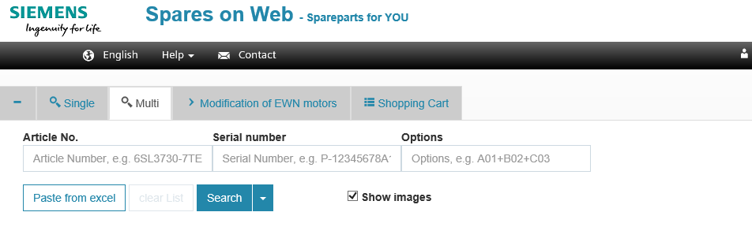
Search Options – Multi Search
After logging in, various input windows are available for entering search criteria:
Multi-search allows you to enter search criteria for several products and systems.
To save time, you can paste an list of components in one step. Ensure, that the Excel-List has the same structure: Article No., Serial Number (if relevant), Options (if relevant). Please ensure the correct syntax of the content to get a result.
→ The search result is displayed in a list view.
→ The option for displaying the images in the result lists can be deactivated

Slide 12
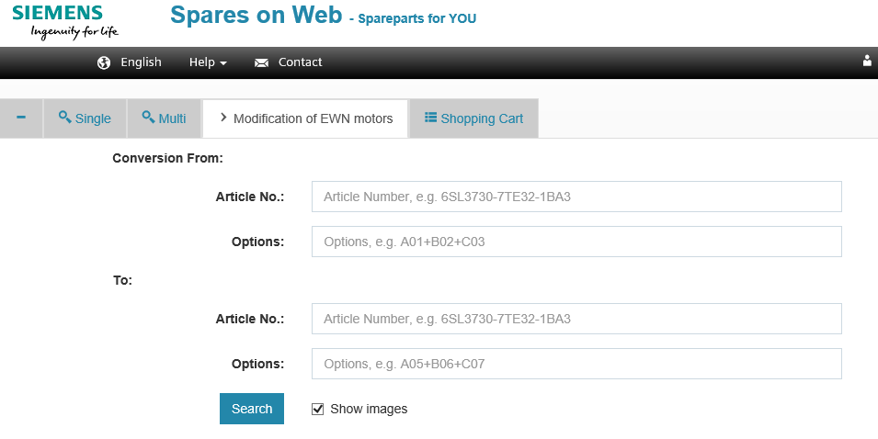
Search Options – Modification of EWN-Motors
The ‘Modification of EWN Motors-Search' helps you, if you want to modify an existing motor.
The input mask gives you the possibility to first enter the article number and possible options for the existing motor and then the article number and possible options for the desired motor.
As search result lists with the parts needed for the modification are shown to you.
The functionality is only visible to users with a corresponding permission.
Notes:
The ‘Modification of EWN Motors-Search' helps you, if you want to modify an existing motor.
The input mask gives you the possibility to first enter the article number and possible options for the existing motor and then the article number and possible options for the desired motor.
As search result lists with the parts needed for the modification are shown to you.

Slide 13
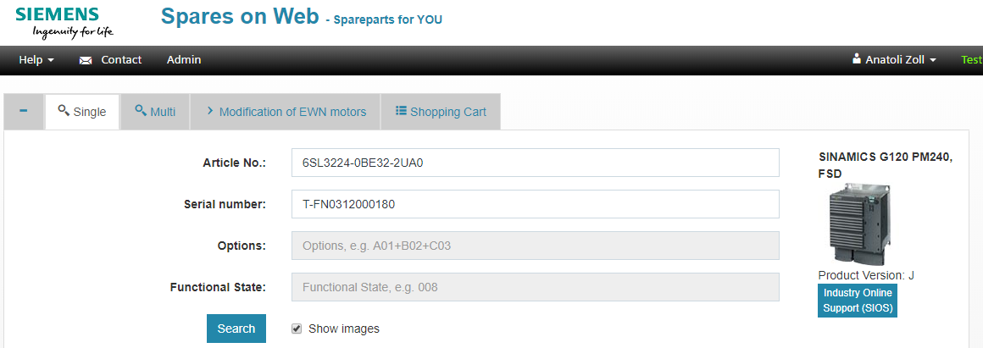
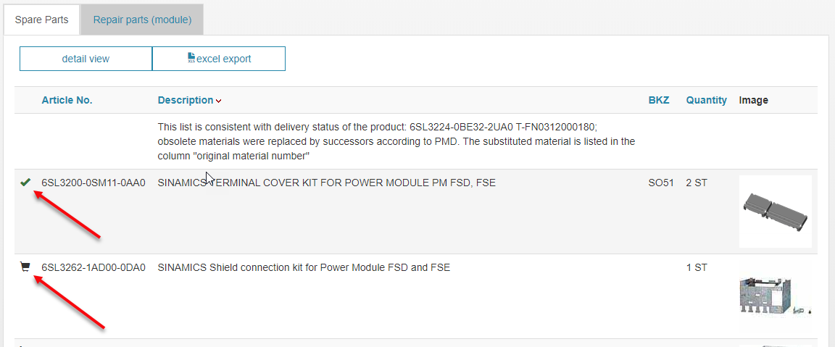
Search Options – Shopping Cart → Service Mall
If you have a Siemens Service Mall account, you can order relevant spare parts directly from Spares on Web by clicking the Cart symbol

Slide 14
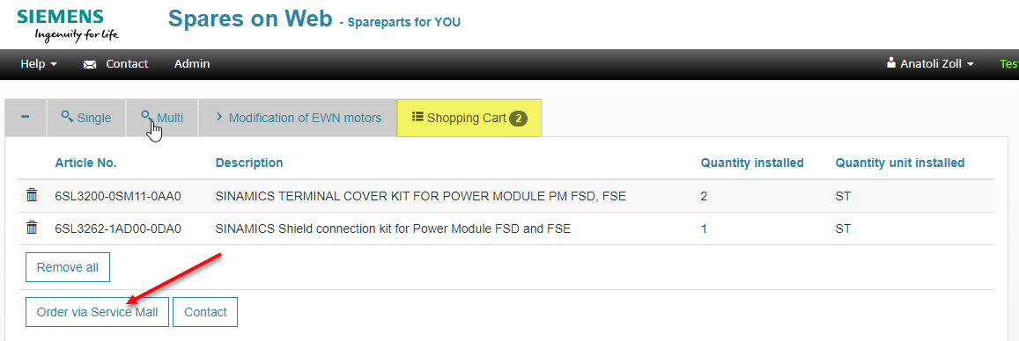
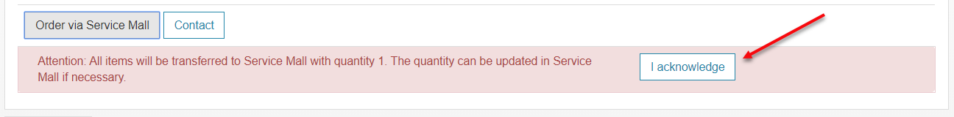
Search Options – Shopping Cart → Service Mall
The transfer to the Service Mall Cart has to be confirmed. Ordering has to be finalized in Service Mall.

Slide 15
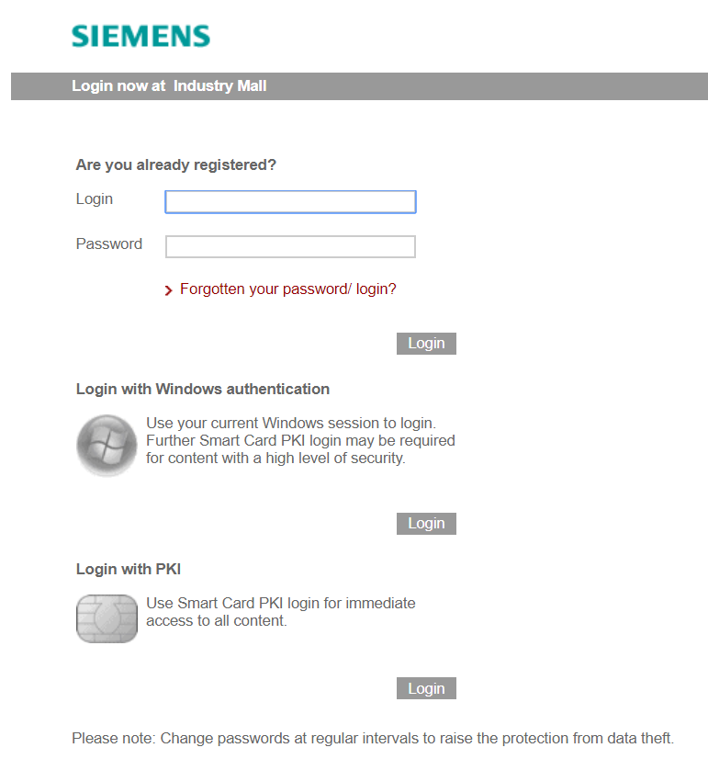
Search Options – Login Service Mall
If you are not logged into Service Mall yet, you will get the prompt to login to finalize your shopping cart.

Slide 16
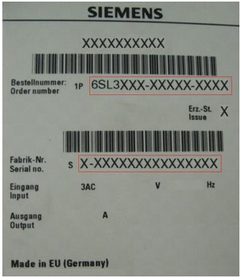
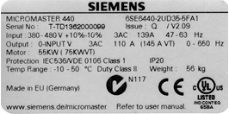
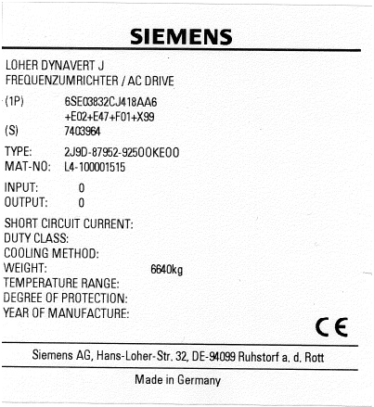
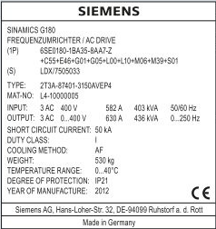
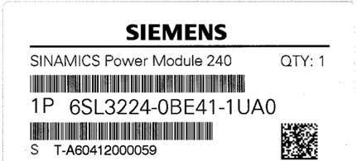
Examples of article numbers and serial numbers – Electronics
Here you can see some examples of type plates of electronic products. The article numbers are yellow and the serial numbers are marked blue.
Notes:
Here you can see some examples of type plates of electronic products. The article numbers are green and the serial numbers are marked red.

Slide 17
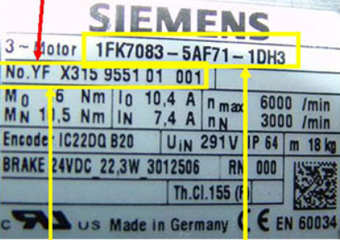
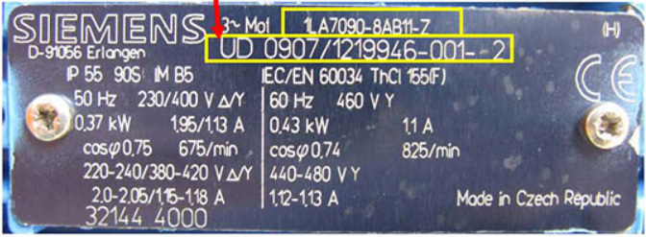
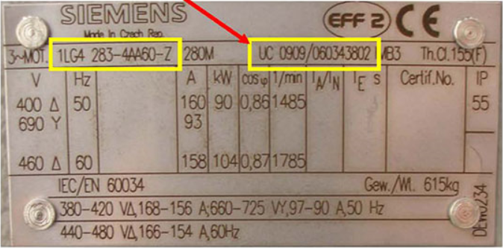
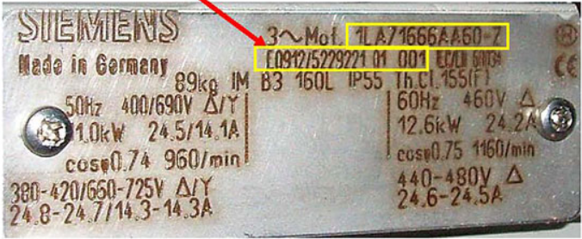
Examples of article numbers and serial numbers – Motors
c
Here you can see some examples of type plates of electronic products. The article numbers are yellow and the serial numbers are marked blue.
Notes:
Here you can see some examples of motor nameplates. The article numbers are green and the serial numbers are marked red.

Slide 18
Result lists
Notes:
In the following we would like to introduce you to various aspects of your possible search results and how you can work with them.

Slide 19
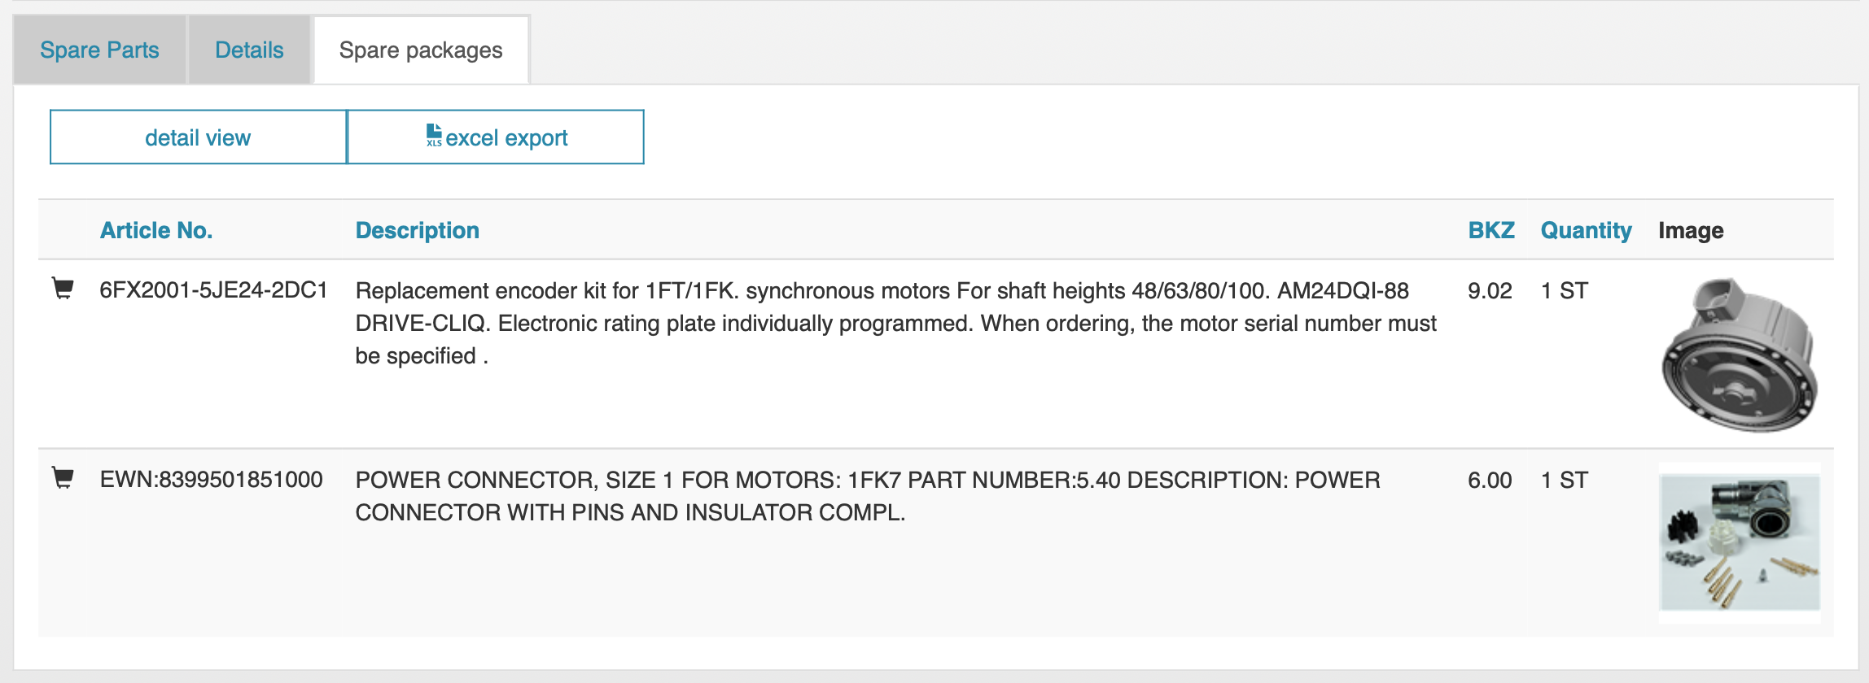
Result lists – Spare parts and spare parts packages
For all users, result lists of Spare Parts or Spare part kits/Packages, Consumables and General wear parts are displayed in the tabs. Logged in users of authorized repair centers and internal Siemens employees also see result lists of repair parts at module and component level, and lists of special wear parts.
Notes:
For all users, result lists of spare parts or spare part kits/packages, consumables and general wear parts are displayed in the tabs of the same name.
Authorized repair centers also see result lists of repair parts at module and component level, and lists of special wear parts.

Slide 20
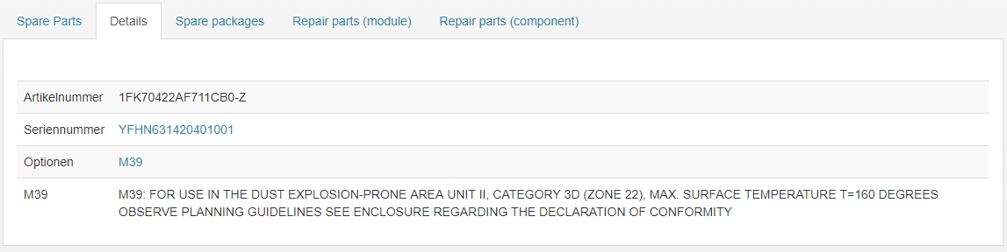
Result lists – Details
If you have carried out a search with article number and additional serial number, you can see the installed options in the tab 'Details’. This detail view exists only for certain products and systems. Siemens employees can also click on the displayed options to obtain a brief description.
Notes:
If you have carried out a search with article number and additional serial number, you can view your search results and the installed options in the tab 'Details’.
This detail view exists only for certain products and systems.
Siemens employees can also click on the displayed options to obtain a brief description.

Slide 21
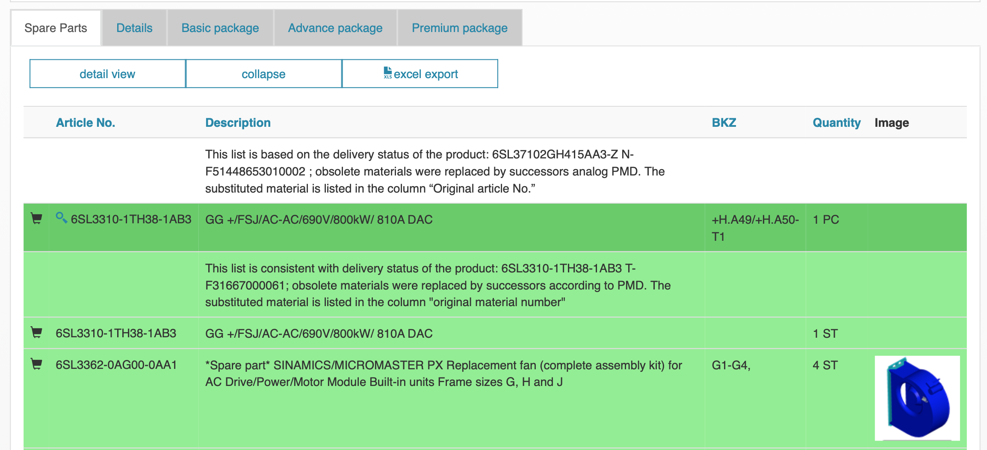
Result lists – Packages & Modules
For certain products, result lists of Basic, Advanced, Premium and other packages are also displayed as additional search results. A result list with spare parts may contain subordinate modules. These modules and their spare parts are highlighted in green and the spare parts (highlighted in light green) can be folded in and out.
By clicking on the magnifying glass icon in front of the article number of the module, a new browser window opens with the search criteria of the module and its result lists are displayed.
Notes:
For certain products, result lists of Basic, Advanced, Premium and other packages are also displayed as additional search results.
A result list with spare parts may contain subordinate modules. These modules and their spare parts are highlighted in green and the spare parts (highlighted in light green) can be folded in and out.
By clicking on the magnifying glass icon in front of the article number of the module, a new browser window opens with the search criteria of the module and its result lists are displayed.

Slide 22
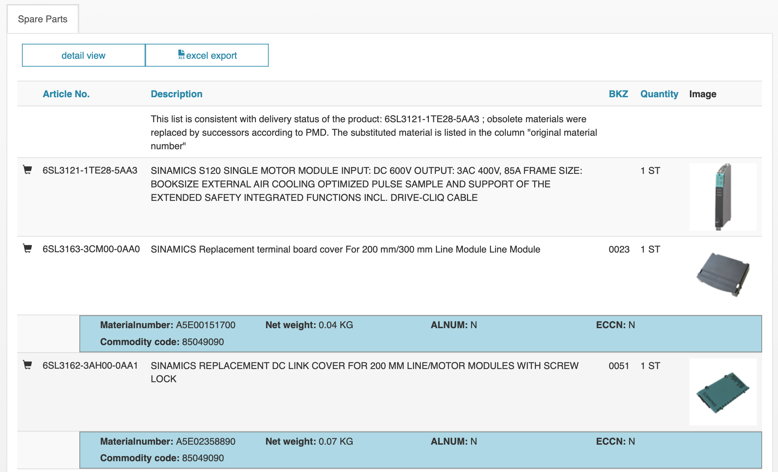
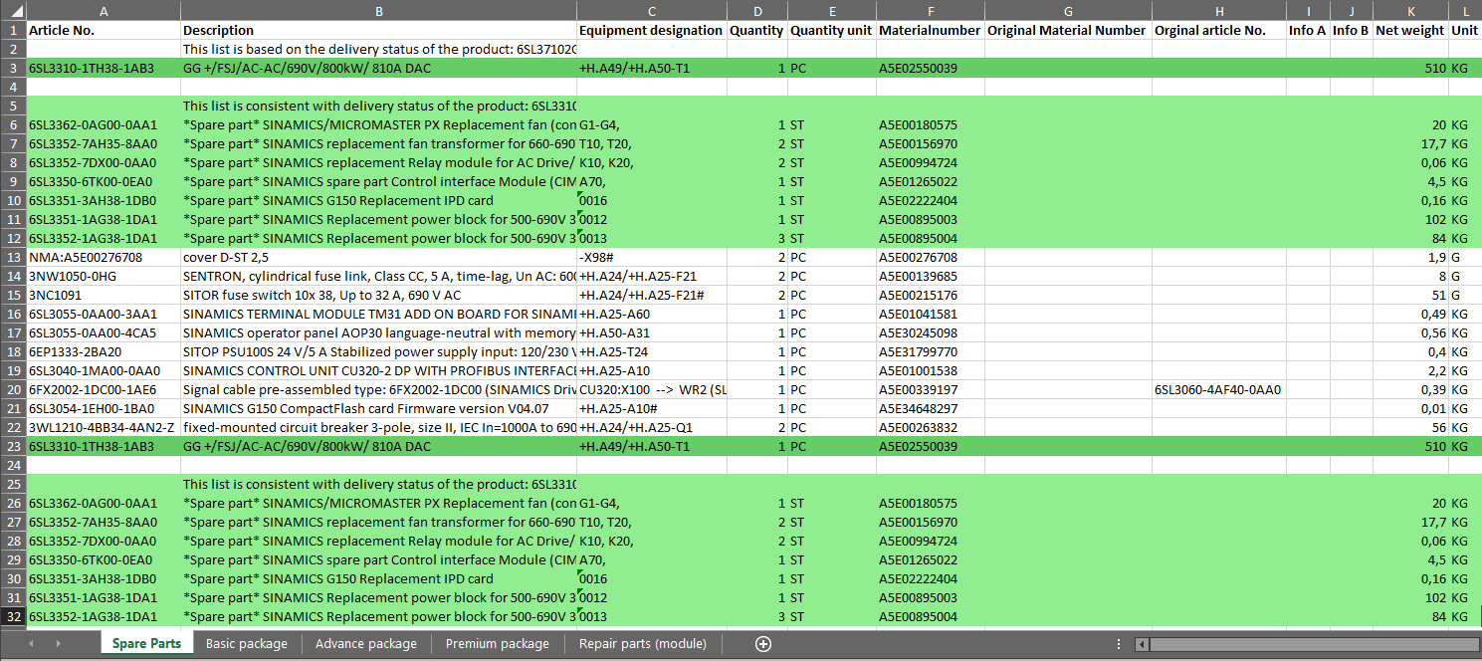
Result lists – Excel-Export
If you want to export your search results to Excel, simply click the 'Excel Export' button.
The Excel export contains all result lists for your search in separate tables.
Notes:
If you want to export your search results to Excel, simply click the 'Excel Export' button.
The Excel export contains all result lists for your search in separate tables.

Slide 23
Thank you very much for your attention!
Unrestricted © Siemens 2020
siemens.com/sow
Notes:
We have reached the end of this Manual. Thank you for your interest, and good luck with Spares on Web!

